Slide 1

Fairness CI in ML

Slide 2
阅读流程
Abstract + Intro + Conclusion
Problems
Solutions
Eval

Slide 3
Abstract + Intro + Conclusion
Abstract
观测数据
使用观测数据中基于protected attributes所带来一些潜在的歧视
也明确了自己研究目标

Slide 4
Intro
Protected attribute
观测数据
现实世界中观察、记录和收集的数据。研究者无法直接控制或者操控数据的形成。
Contribution points
Revisiting the two scenarios proposed .
algorithms

Slide 5
Related work
Demographic parity
通俗来说对不同人群的统计数据。
A
B

Slide 6
Conclusion
框架
目标
resolving variables & proxy variables
solutions
limitations to solutions.

Slide 7
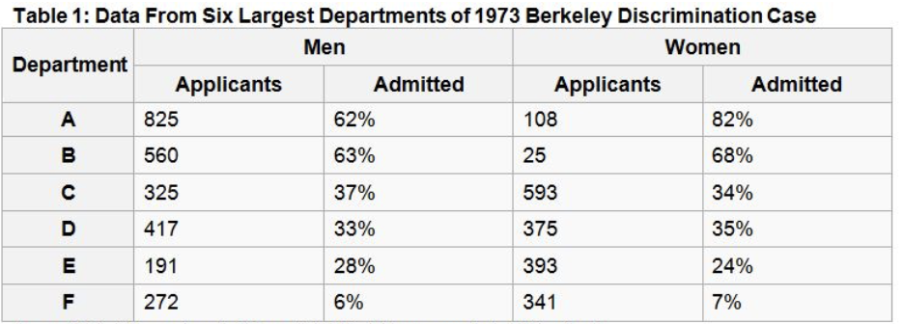
Unresolved discrimination
1973年，44%男性学生vs only 35%女性学生被录取。（整体的录取率）

Slide 8
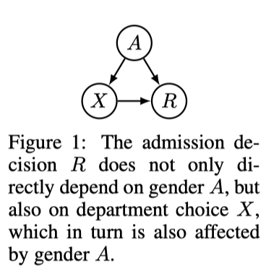
A是protected attribute, 代表性别；
X表示录取的department院系；
R表示被录取.

Slide 9
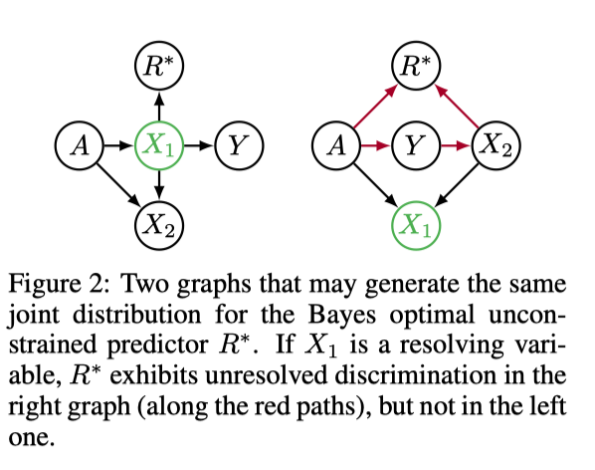
unresolved discrimination
A variable V in a causal graph exhibits unresolved discrimination if there exists a directed path from A to V that is not blocked by a resolving variable and V itself is non-resolving.
All paths from the protected attribute A to R are problematic, unless they are justiﬁed by a resolving variable.

Slide 10
Proxy Discrimination
锻炼频率
血压
心脏疾病风险

Slide 11
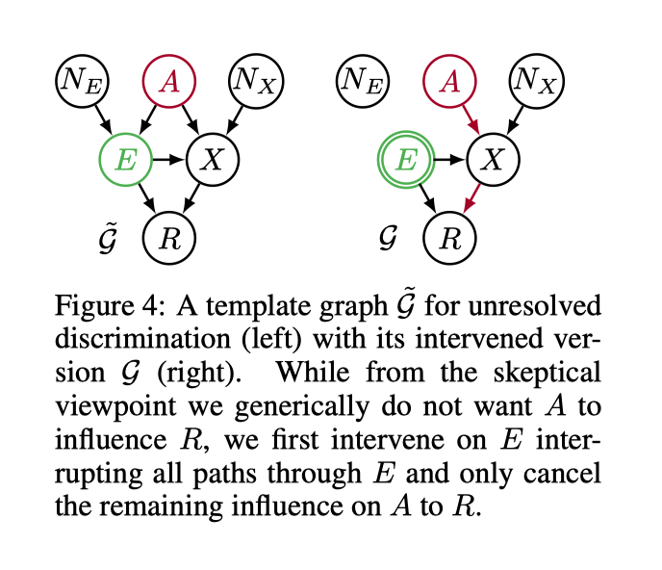
How to solve?

Slide 12
Intervene on E
E = α_{E}A + N_{E} , => E = η
X = α_{X}A + βE + N_{X}
R_{θ} = λ_{E}E + λ_{X}X
By iterative substitution
E = η
X = α_{X}A + βE + N_{X}
R_{θ} = λ_{E}E + λ_{X}X...
....
R_{θ} = (λ_{E}+ λ_{X} β)η + λ_{X}α_{X}A + λ_{X} N_{X}
We now demand the distribution be invariant

Slide 13
Evaluation
梳理了机器学习中变量之间带来的一些潜在的歧视
不容易应用
Future work
对于目前我们所接触到数据，利用这个思路，看能不能develop新的算法去避免数据之间的歧视

